Slide 1
HTTP
HTTP stands for "Hyper Text Transfer Protocol", the primary technology protocol on the Web that allows linking and browsing.
This is the technology used to communicate between web servers and web users.
This protocol is the foundation for large, multi-functioning, multi-input systems - like the World Wide Web.

Slide 2
Advantages of HTTP
Identification
Specialization
Addressing
Flexibility
Security
Ease of Programming
Search Capabilities

Slide 3
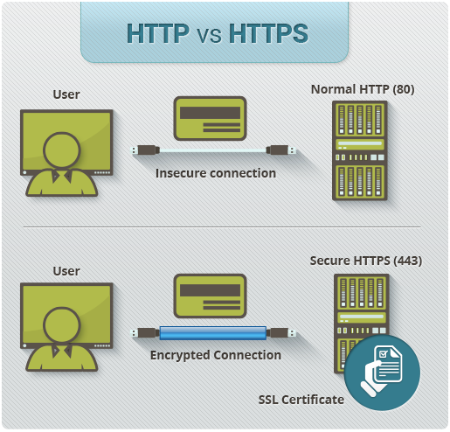

Slide 4
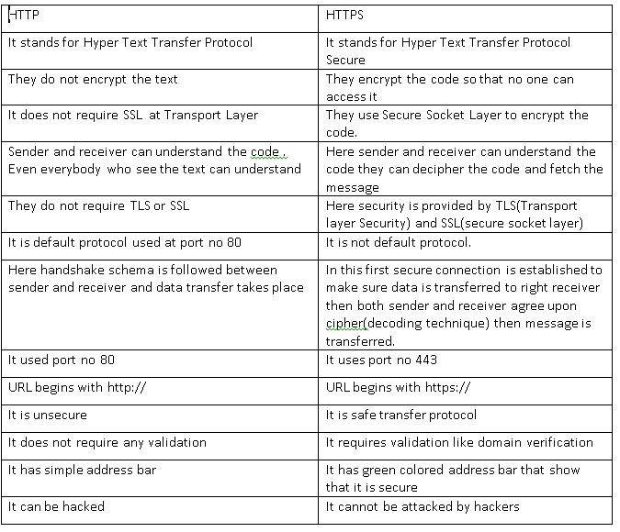
HTTP v/s HTTPS

Slide 5
NTP
Network Time Protocol (NTP) is a protocol used to synchronize computer clock times in a network.
The term NTP applies to both the protocol and the client-server programs that run on computers.
It is used to achieve highly accurate time synchronization and to sustain the effects of variable latency over packet-switched data networks through a jitter buffer.

Slide 6
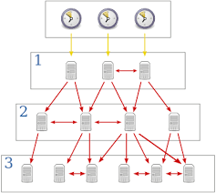
How does it works?

